Slide 1
Covex OTS
Peer Review & Dry Run Training

Slide 2

What is a Peer Review?
A review process that is an important part of validation.
1. It helps to ensure the author covered all functionalities that were defined in the requirement specifications.
2. A reviewer, is responsible for recognizing mistakes that the author happened to overlook.

Slide 3
Prior to Peer Reviewing:
1. Check that all Parameters listed are being used within the Test Script.
a. Parameter: is a constant, or variable given a specific value during execution.
b. CTRL+ F can assist in finding / identifying all parameters.
2. Make sure that the Step #’s are in proper order.
3. Verify that all requirements listed are correctly numbered in the Test Script.
4. All requirements need to be referenced in the Test Script and those referenced need to be cross checked (Alt + A + F9).
5. If a requirement has different components such as part a, b, and c then all parts of the requirement need to be verified in more than one test step, or across multiple Test Scripts.
NOTE* - Ensure all parts are tested

Slide 4
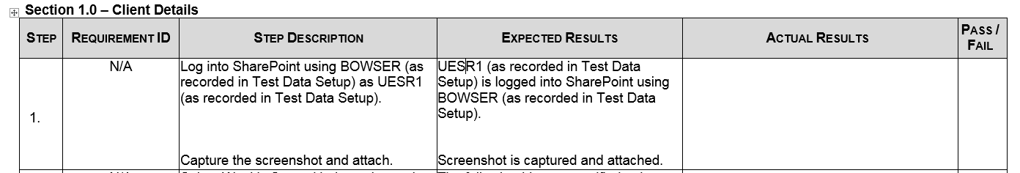
Spelling Mistakes:
To avoid Spelling Errors
a. Always do a quick f7 to catch common spelling issues. Misspelling of words can lead to confusion, poorly structured sentences, and misdirection of instructions within the Step Description.

Slide 5
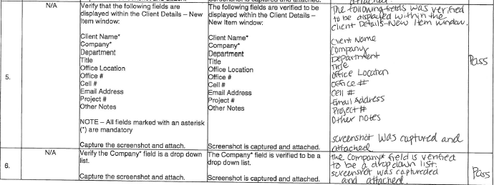
Grammar Mistakes:
1. Grammar (f7 also checks this)
a. Verify that the tense is correct.
b. Be mindful that present tense is used ONLY in Step Description & Expected Results.
c. Misuse of grammar can lead to skewed, or wrong results.
d. This also includes language, which should be easily understood.
Use the Principle: K.I.S.S -> Keep It Simple Silly

Slide 6
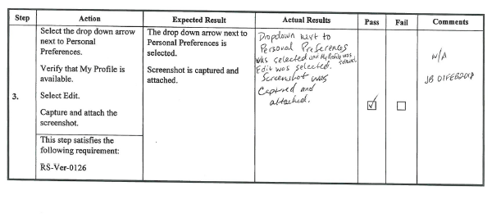
Importance of a Good Template:
1. Template format
a. Ask the author if the client requested the use of a certain template. If so, use those guidelines to confirm the format was properly followed
(i.e. check boxes for Pass / Fail, split columns to show requirements).
b. An organized Test Script will make it easy to go back and make any updates, or changes in the future.
Below is an example of a Client suggested format:

Slide 7
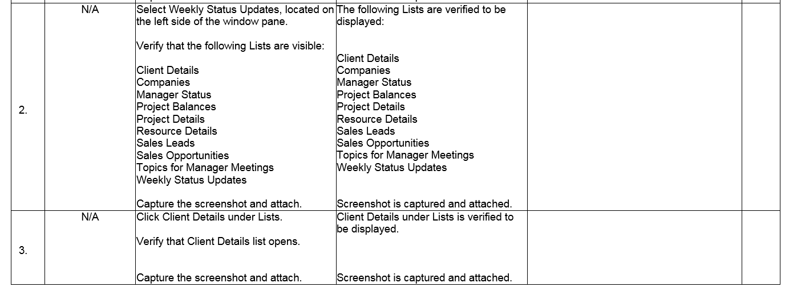
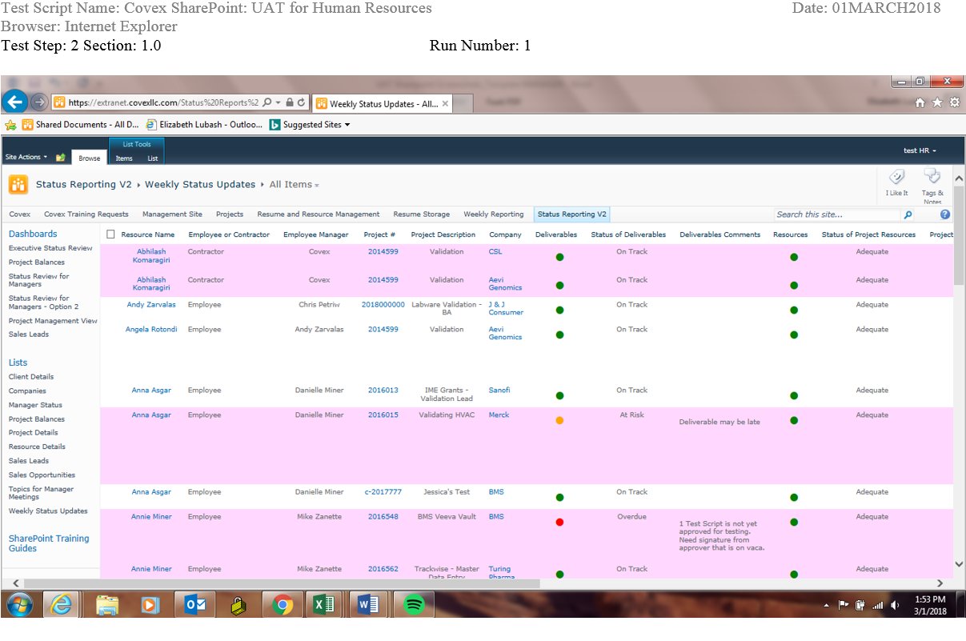
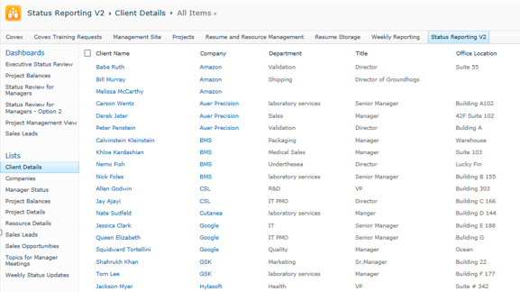
Things to be conscious of:
Replication
a. If a test step can be combined, or merged into one step due to the testing of the same requirement, or functionality than this should be done.
b. Remove any duplicated test steps.
Example: The test steps could have been combined because the Lists are visible in both, which are verified by the screenshots.
Step 2: A segment of the Screenshot
Step 3: A segment of the Screenshot

Slide 8
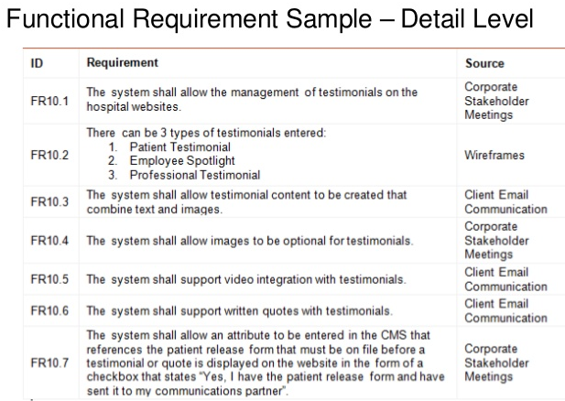
Things to be conscious of (Cont.):
2. Functionality
a. When reviewing a Test Script please ensure that all functionality that is being tested in the system is covered within the Test Script.
i. This helps to prevent defects.
Below: All listed FR’s need to be cross reference within the Test Script to ensure thorough testing.

Slide 9
Points to Remember:
1. Ask for a copy of the Software Requirement Specification / Functional Requirement Description this way it can be used as a point of reference to make sure everything that needs to be tested, was actually tested.
a. Also, it allows the reviewer the ability to check that the test step fully validates the requirement.
2. If the reviewer, has access to the system use it.
a. This will give them a better understanding of the execution steps and Expected Results.
3. Important to Remember:
a. The review process should be taken slowly because a proper review can aid in the prevention of defects.

Slide 10
What exactly is a Dry Run?
A dry run is a static test that should be performed in order to mitigate the failure of a software, or product.
a. Static test: is not executed, but checks requirement & design documents to find errors.
1. This is used in prevention, so the end user does not receive a product that is filled with issues and bugs.
2. Basically, the person who is dry running the Test Script is responsible for navigating through the test steps and Expected Results to find errors and suggest corrections.

Slide 11
Things to be mindful of while Dry Running:
1. Make sure the task being asked to perform is clearly communicated and fully understood.
If you have further questions, or don’t understand follow up with the author for clarification. Don’t take anything personally! If your comments are rejected take it as a learning experience.
2. If a Step Description is TOO long it can cause the User to get lost, or confused.
a. Suggest any tasks that can / should be broken down for further simplification.
b. It can be necessary to do more than one run to check for things such as the cross reference of requirements, test scenarios, spelling & grammar, and the overall flow of the script.
3. Verify that all required steps can be completed.
a. Follow the Test Script exactly how it is written.
b. Report, or note when things do not work.

Slide 12
Things to be mindful of while Dry Running (Cont.):
4. Check to make sure all numbers are in order; no gaps or repeats.
5. Verify that all parameters are mentioned in the setup and also, within the script.
6. If there is a list of requirements compare those to make sure all components are being tested in the script, or across multiple scripts.
7. Check all links, or emails to ensure proper functionality.
a. If something is not working appropriately it can be addressed.
i. An example, would be if the user cannot log into a specific e-mail then this can be fixed immediately, or at least noted.

Slide 13
Things to be mindful of while Dry Running (Cont.):
8. Capturing Screenshots
a. This allows for proof that the step exactly matches the Expected Results, or not.
b. If it does not exactly match the Expected Results than the author can see where the necessary changes need to be made (i.e. words mismatching, missing words, or a window / selection of a button they may have entirely missed).
9. Check for additional spelling / grammar issues that were overlooked in the peer reviews.
10. Overall, make sure the language is clear and concise for the end user.

Slide 14
Words / Phrases to Check for:
The Author should avoid using certain Words / Phrases when writing Test Scripts, so please comment / note if they appear.
Stay away from these Words / Phrases:
“all”
“never”
“always”
“best”
“optimal”
“fast”
“immediate”
“usually”
“generally”
“for example”
“such as”
“including, but not limited to”
“approximately”
“may”
“some”
“should”
“many”
“sometimes”
“and”
“or”
“and/or”
“then”

Slide 15

Questions?
COVEX, LLC

